Slide 1

Title: Cyber Threat Detection Using Machine Learning Techniques: A Performance Evaluation Supervised Machine Learning Algorithms In Intrusion Detection
Presented by:
Suleyman Olushola Yahaya
MSc Data Science
M00736597
Supervised by:
Dr Maha Saadeh
10th May 2022
Faculty of Science and Technology
Computer Engineering & Informatics
Individual Project
CST 4090

Slide 2



PROJECT OUTLINE
Project Abstract
Aim and Objectives
Cyberspace
Intrusion and Intrusion Detection Sysems
NSL- KDD Dataset
Project Methodology
Evaluation of Findings
Conclusion
Recommendations

Slide 3
Project Abstract
By monitoring, detecting, and responding to unauthorised activities within the system, an Intrusion Detection System should be able to recognise any anomalous patterns in traffic. However, as the proliferation of online transactions increases internationally across industries, the frequency of cyber-crime rises, making it harder for intrusion detection systems to keep up and detect data breaches and prevent data leaking. Machine Learning approaches are being used to detect intrusions and address these threats.
The detection of intrusions using simulated data has recently been identified as a possible application area for these approaches. This research compares some of the most extensively utilised Supervised Machine Learning algorithms to detect intrusions using the NSL KDD dataset. The five machine learning techniques evaluated include Random Forest, k-Nearest Neighbour, Decision Tree, Naive Bayes, and Support Vector Machines. The experimental results obtained showed that the Support Vector Machine produced the best results in classifying and identifying intrusion and routine network traffic with an average accuracy of 76%, an AUC of 0.84, an F1 score of 81%, and a Recall average of 70% o over the rest of the classification algorithms.

Slide 4
Project Aim and Objectives
Project Aim:
This project aims to evaluate the performance of selected machine learning algorithms in differentiating between intrusions/attacks and normal activities within the NSL KDD dataset. Five supervised machine learning algorithms have been chosen to perform these tasks. Namely; Random Forrest, Decision Trees, Support Vector Machines, K-Nearest Neighbour, and Naïve Bayes.
Project Objectives:
The objectives of this research is to investigate how effective have machine learning approaches been in detecting intrusions and also, determine how the findings of research compare to other studies of a similar nature.

Slide 5
Cyberspace and Threats
Cyberspace
Computer Security Resource Centre (CSRC) defines the cyberspace as a global domain within the information environment consisting of the interdependent network of information systems infrastructures including the Internet, telecommunications networks, computer systems, and embedded processors and controllers.
Threats
Cyberspace is susceptible to threats such as Malware, Denial of Service Attacks (DOS), Phishing, Zero-Day exploits etc.

Slide 6
Intrusion and Intrusion Detection System
Intrusion
An unlawful and unauthorised activity within a digital network.
Intrusion Detection
The capacity to monitor and respond to computer misuse is known as intrusion detection.
Intrusion Detection Systems
A network monitoring device or software program that looks for harmful activities or policy infractions.

Slide 7
Types of Intrusion Detection Systems
Anomaly-Based System
Signature-Based System
Hybrid-Based System

Slide 8
NSL-KDD Dataset
Released as an improved version of KDD’99 dataset.
Regarded as the benchmark data set to evaluate intrusion detection systems.
Train and test subsets (KDDTrain+ and KDDTest+).
Contains 42 total features, with ‘Class’ being the target feature.
The class feature contains 23 categories
Contains no redundant or missing values.

Slide 9
The intrusion in NSL KDD Dataset and its subclasses are listed in the table:
Class | Subclass
Denial of Service (DoS) | Apache2, Back, Land, Neptune, Mailbomb, Pod, Processtable, Smurf, Teardrop, Udpstorm, And Worm.
Probe | Ipsweep, Mscan, Nmap, Portsweep, Saint, And Satan.
User to Root | Buffer Overflow', Loadmdoule, Perl, Ps, Rootkit, Sqlattac, And Xterm.
Remote to Local (R2L) | Ftp_Write, Guess_Passwd, Http_Tunnel, Imap, Multihop, Named, Phf, Sendmail, Snmpgetattack, Snmpguess, Spy, Warezclient, Warezmaster, Xclock, and Xsnoop.

Slide 10
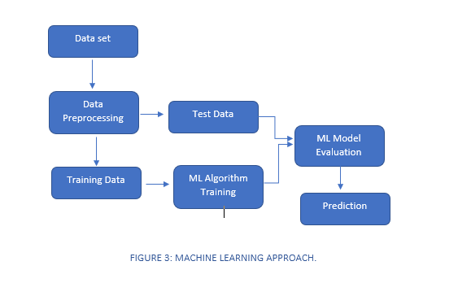
Project Methodology
The steps employed include:
Data Exploration
Data Preprocessing
Modelling
Evaluation of Models

Slide 11
Evaluation of Findings
Models | Train Accuracy | Accuracy Score | F1 Score | Precision | Recall | AUC
Random Forest | 0.99 | 0.78 | 0.78 | 0.90 | 0.68 | 0.79
Decision Trees | 0.99 | 0.79 | 0.81 | 0.86 | 0.76 | 0.80
Naïve Bayes | 0.89 | 0.57 | 0.73 | 0.57 | 0.99 | 0.50
K-nearest Neighbours | 0.99 | 0.77 | 0.76 | 0.97 | 0.62 | 0.86
Support Vector Machines | 0.99 | 0.82 | 0.81 | 0.98 | 0.70 | 0.84

Slide 12
Conclusion
The findings of an evaluation of the performance of five supervised algorithms for detecting intrusion in network traffic are discussed in this research: Nave Bayes, support vector machine, Random Forest, decision tree, and K-nearest neighbour. These algorithms were evaluated using Accuracy, Recall, precision, F1 and AUC using the NSL-KDD dataset.
The Nsl KDD dataset comprises 23 types of assaults. The study's goal is to distinguish between intrusions and regular network activity. The classes were binned into "Normal" for regular activity and "intrusion" for intrusions, making them binary classification jobs.
The results show that the Support Vector Machine Classifier obtained the best identification of intrusion and routine network traffic with an average accuracy of 76%, an AUC of 0.84, an F1 score of 81%, and a Recall average of 70% o over the rest of the classification algorithms. The Decision Tree Classifier came closest as it recorded an average accuracy score of 79%, 81% F1 score, 86% Precision, a recall average of 76% and an AUC of 0.83.

Slide 13
Recommendation
Cross Validation
Deep Learning Methods
Ensemble Learning Methods
Investing in Dedicated Resources

Slide 14
Thank You!

